Slide 1


CORONA VIRUS ANALYSIS
Presented by
Kanimozhi

Slide 2

INTRODUCTION
The CORONA VIRUS pandemic has had a significant impact on public health and has created an urgent need for data-driven insights to understand the spread of the virus.
As a data analyst, I analyse a CORONA VIRUS dataset to derive meaningful insights and present your findings.

Slide 3




DATASET OVERVIEW
Province: Geographic subdivision within a country/region.
Country/Region: Geographic entity where data is recorded.
Latitude : North-south position on Earth's surface.

Slide 4


Longitude: East-west position on Earth's surface.
Date: Recorded date of CORONA VIRUS data.
Confirmed: Number of diagnosed CORONA VIRUS
Cases.

Slide 5



Deaths: Number of CORONA VIRUS related deaths.
Recovered: Number of recovered CORONA VIRUS Cases.

Slide 6
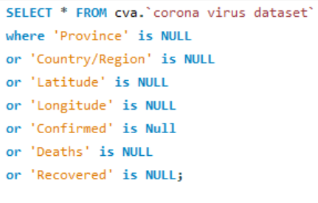
Data exploration and analysis
1.Write a Code to Check NULL Values.

Slide 7
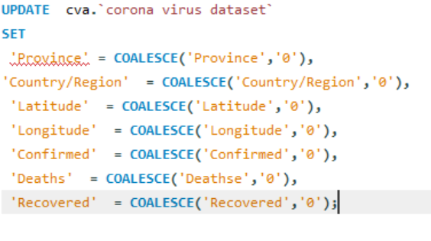
2. If NULL values are present , update them with Zeros for all columns.

Slide 8
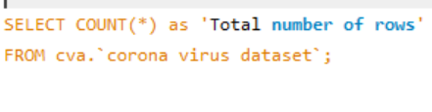
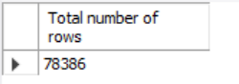
3.Check total number of Rows.

Slide 9
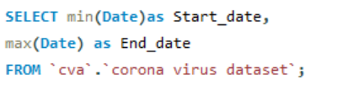
4.Check what is Start_Date and End_Date.
Start_date End_date
22/01/2020 13/06/2021
5. Number of MONTHS Present in dataset.
Number of Months :18

Slide 10
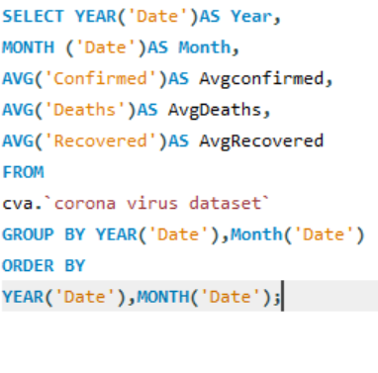
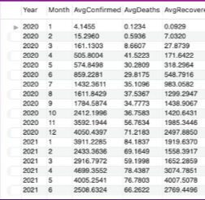
6.Find monthly average for Confirmed,Deaths,Recovered.

Slide 11
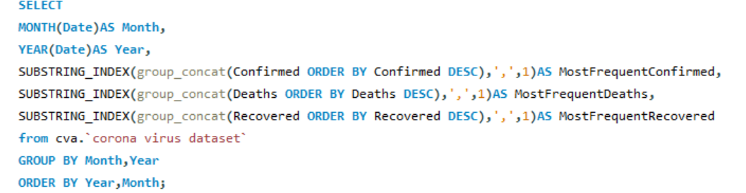
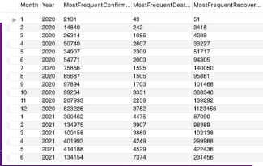
7.Find most Frequent value for Confirmed,Deaths,Recovered each month.

Slide 12
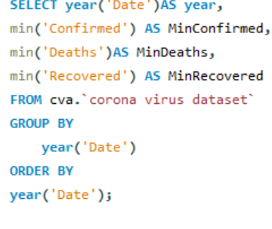
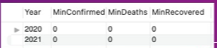
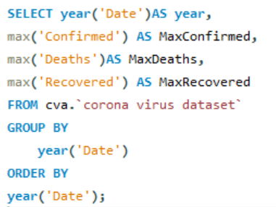
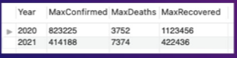
8.Find minimum values for Confirmed, Deaths ,Recovered per year.
9. Find maximum values for Confirmed, Deaths ,Recovered per year.

Slide 13
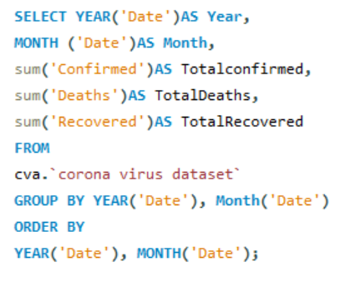
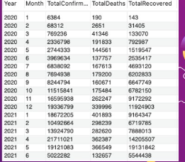
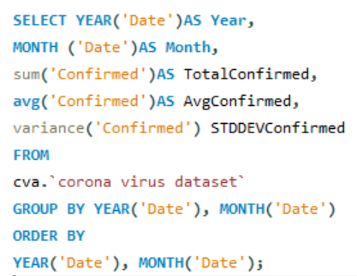
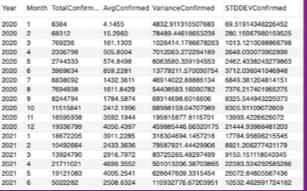
10. The total number of case of Confirmed, Deaths,Recovered each Month.
11. Check how Corona Virus spread out with respect to Confirmed case.

Slide 14
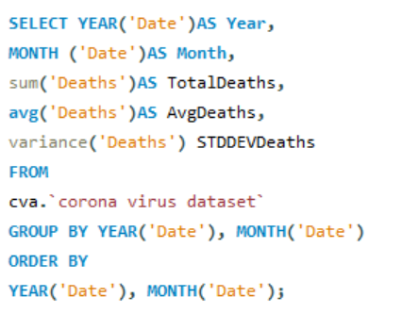
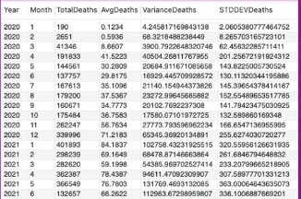
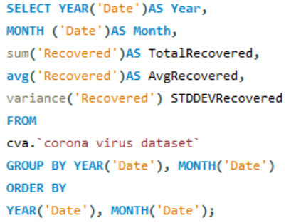
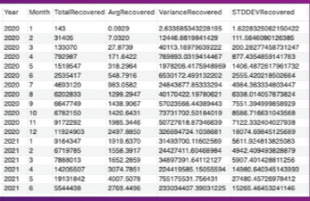
12. Check how Corona Virus spread out with respect to Deaths case.
13 . Check how Corona Virus spread out with respect to Recovered case.

Slide 15
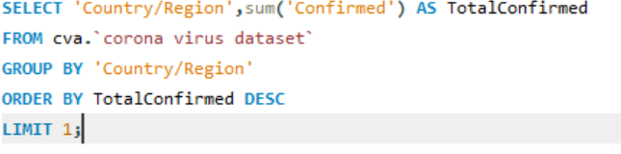
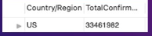
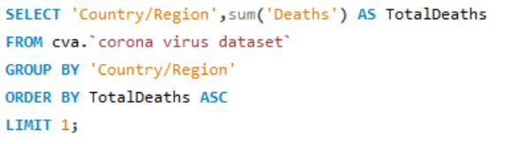
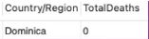
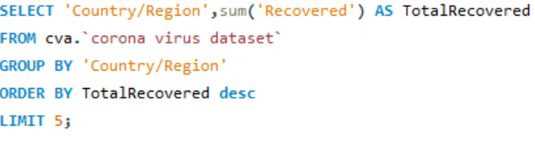
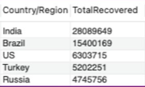
14. Find Country having highest number of the Confirmed case.
15. Find Country having lowest number of the death case.
16. Find top 5 countries having highest recovered case.

Slide 16
CONCLUSION
THANKS

